Slide 1
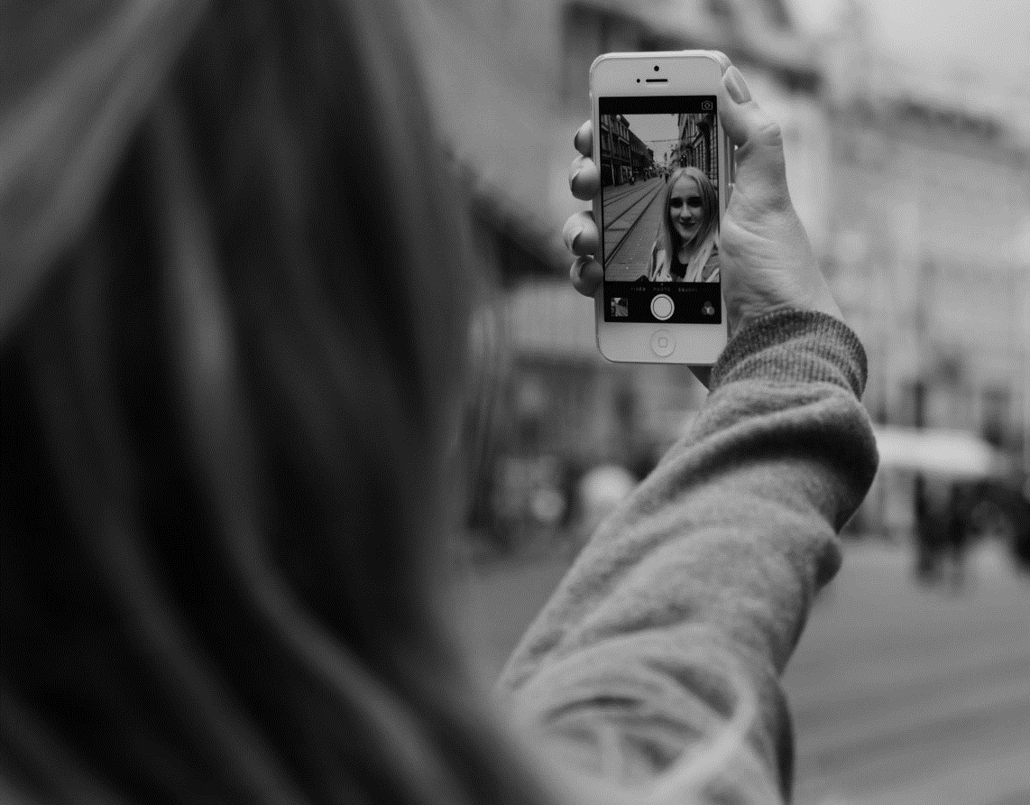
Your walk talks, your talk talks
your walk talks louder than your talk talks (x2)
Walk not in darkness as children of the night
Walk even as Jesus walked, walk as the children of light

Slide 2
Cellphone vLj;J selfi gplpf;Fk; jk;gp jq;ifNa
,NaRitg;Nghy Ngrp ghU vd;Wk; ntw;wpjhd;
Cellphone vLj;J selfi gplpf;Fk; jk;gp jq;ifNa
,NaRitg;Nghy ele;J ghU vd;Wk; ntw;wpjhd;

Slide 3
Facebook twitter whatsapp ellam time waste Mf;FNk
Daily bible glpr;R ghU taste M ,Uf;FNk
Post, Like, Share gz;zp Nkhrk; NghfhNj ,NaRitg;Nghy tho;e;J ghU Nkhl;rk; NghthNa

Slide 4
Cellphone vLj;J selfi gplpf;Fk; jk;gp jq;ifNa
,NaRitg;Nghy Ngrp ghU vd;Wk; ntw;wpjhd;
Cellphone vLj;J selfi gplpf;Fk; jk;gp jq;ifNa
,NaRitg;Nghy ele;J ghU vd;Wk; ntw;wpjhd;

